Slide 1
Birth register
System

Slide 2
Background
Birth register system is website that help people to register their child born.
A well developed and functioning civil registration system ensures the registration of all vital events including births, deaths and issues relevant certificates as proof of such registration. Civil registration promotes efficient government planning, effective use of resources and aid. And more accurate monitoring of progress towards achieving the sustainable development plan.

Slide 3
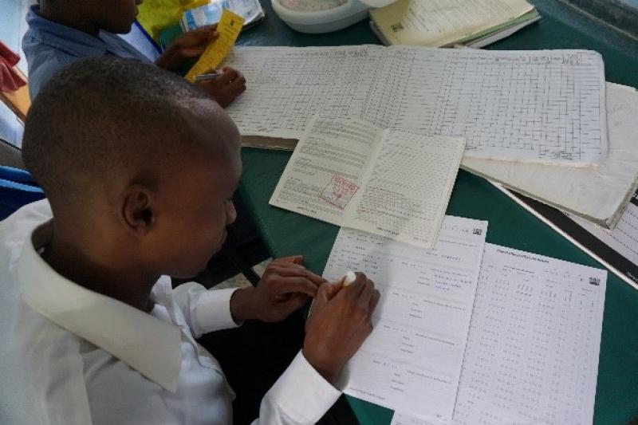
Problem statement
Holidays of leaders, when a leader who is responsible to record children born are not around, is possible some people may miss in the record of a child born.
Children born with some infections and other problems such as low body mass.
Loss of documents, and reduction of paperwork

Slide 4
Similar system
Child register is a free website that helps people to register a child born and it gives the online birth certificate
Irembo service is a platform that assists the citizens to submit the application and make payment for various services.
vital statistics system are critical for both a country and its residents, as it records significant demographic data such as births, deaths, marriages, and divorces.

Slide 5

Haw it work
People can register their child without movement, it shows how that birth register system works, its significance, and the positive impact it brings within society..
It helps people to register a child born easily and this helps people to make registration at the right time and this helps people to do it anytime they want and especially it helps countries to make a real budget according to real population number.
System helps people to register child born in an easy way and this helps people to make registration at the right time and this helps people to do it anytime they want and especially it helps countries to make a real budget according to real population number.

Slide 6
Limitation
In the case of teenage pregnancy and rape case

